Slide 1
CS 447/647
User Management

Slide 2
Goals
What is a user?
How is account information found?
How do you add, modify and delete users?
What are some common authentication backends?
What is the role of /etc/passwd, /etc/group and /etc/shadow?
What are the parts of an encrypted password in /etc/shadow?

Slide 3
User Management
Modern Systems
Physical
Virtual
Cloud
Account Models
Classic?
Network-based (>1990’s)
Security
Notes:
Authentication and authorization spans Physical, Virtual and Cloud
centralized and structured account management.
Traditional 1980’s
Company of any sizes uses network based auth
Security, account hygiene is important
Infrequently used accounts are often targeted by attacks
Get-ADUser -Identity newellz2 -Properties *
Active Directory - Active like active X
Directory - LDAP
Tools - important to know what they are changing

Slide 4
Account Mechanics
What is a user?
A UID, unsigned 32 bit integer
Companion GID, also an unsigned 32 bit integer
System API for users
getpwuid (man 3 getpwuid), get password file entry
getpwnam (man 3 getpwnam), get password file entry by username
Traditionally uses /etc/passwd
How does the OS find users?
Modern systems use Name Service Switch (/etc/nsswitch.conf)
ordered, /etc/passwd & /etc/group first
getent passwd $USER
Notes:
This module also ensures that the root and nobody users and groups (i.e. the users/groups with the UIDs/GIDs 0 and 65534) remain resolvable at all times, even if they aren't listed in /etc/passwd or /etc/group, or if these files are missing.

Slide 5
nsswitch.conf
Many backend databases for:
passwd
group
shadow
services
Why is your UNR login called a NETID?
NETID_AUTHORITATIVE = TRUE|FALSE
Notes:
Services db maps services to ports
NetID is the name for NIS

Slide 6
Pluggable Authentication Modules (PAM)
Provides an interface to authentication
Login utility calls the pam library
Iterates over a stack composed of modules
Configuration in /etc/pam.d/*
Log information in /var/log/auth.log
Example:
module-type control-flag module-path [arguments]
Notes:
/etc/pam.d/common-auth
/etc/pam.d/login

Slide 7
pam_unix.so - /etc/passwd file
List of local users
Traditionally contained passwords
Now in /etc/shadow
File Format:
Login name
Hashed password placeholder (x = /etc/shadow)
User ID
Group ID
GECOS - Full name, office, phone number
Home directory
Login Shell (/bin/bash)
Notes:
head -n 5 /etc/passwd
GECOS - Ken Thompson worked for GE

Slide 8
/etc/passwd - Login Name
Must be unique
Limited to 32 characters
Lowercase
Case-sensitive
Email RFC5321 - everything before the @ should be case sensitive.
ben@📪.ws - https://tinyprojects.dev/projects/mailoji
Easy to remember
Traditionally initials, IE: rms (Richard M Stallman)
Generating usernames often creates duplicates
newellz2
Should be the same across machines
More difficult than you think, IE: eadmin
Often requires orchestration. Ansible
Notes:
Have to expect duplicates. Come up with a procedure (adding a number)

Slide 9
/etc/passwd - Encrypted Password
Originally DES
Cracked with brute-force in 1998
MD5 for while
SHA-512 for a while
Currently salted yescrypt
Changing algorithm does not update existing passwords
chage -d 0 $USER
Algorithm in /etc/pam.d/common-password
password [success=1 default=ignore] pam_unix.so obscure yescrypt
md5, bigcrypt, sha256, sha512, blowfish
rounds=n
obscure - palindrome, similar, case, simple, rotated
man 8 pam_unix
Moved to /etc/shadow

Slide 10
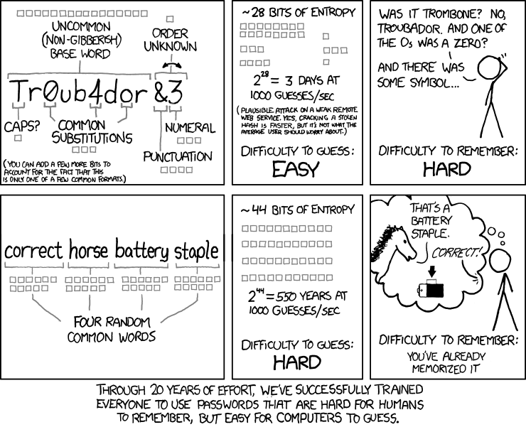

Slide 11
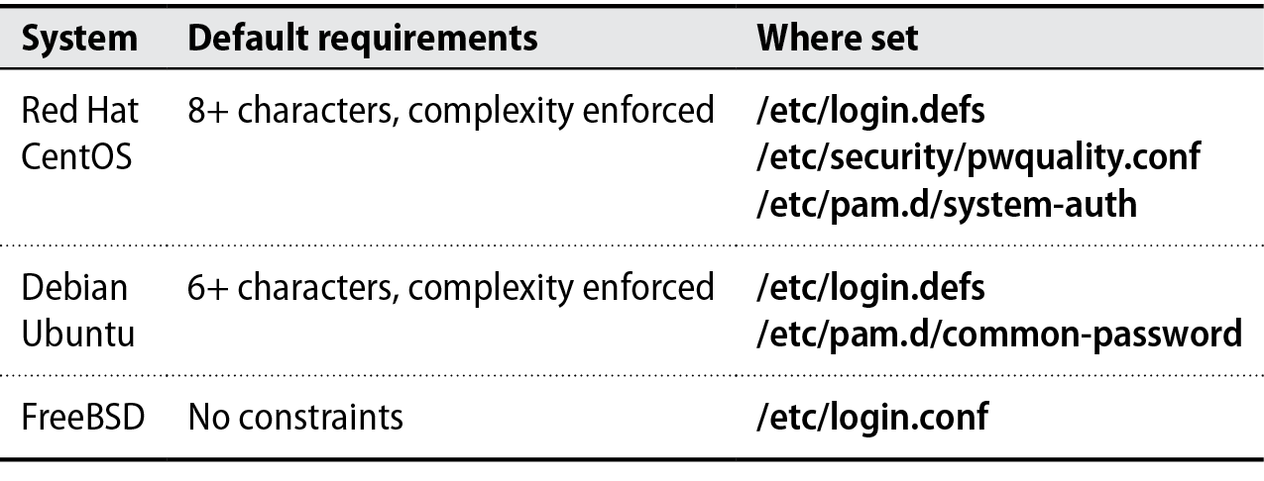
Requirements

Slide 12
/etc/shadow - Encrypted Password
testuser:$6$YaimArFO$Irky4U6vstXuRs3vm.:
$1$ - MD5
$2$ - Blowfish
$5$ - SHA-256
$6$ - SHA-512
$y$ - yescrypt

Slide 13
/etc/passwd - UID
UID 0 for root
System users < 1000
/bin/false shell
Real users >= 1000
We use 5000+ for orchestration accounts
3,000,000+ for AD users
Do not recycle UIDs
Backups
Should be globally unique
Assign ranges to groups, IE CSE = 100,000 - 200,000
Directory Server - LDAP, AD, FreeIPA (All LDAP)

Slide 14
/etc/passwd - GID
GID 0 for root
System < 1000
No consistencies across OS or distros
bin
GID1 on Redhat\CentOS
GID2 on Debian\Ubuntu
GID7 on BSD
Often used for accounting and access control
files, quotas, SLURM partitions, CPU resources
Group information stored in /etc/group

Slide 15
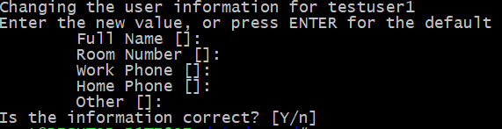
/etc/passwd - GECOS
General Electric Comprehensive Operating System
1962 GE Operating System
Printing
Stored as comma separated value
chfn - allows users to modify
Users can modify
chfn - /etc/passwd only
usermod -c “Zach Newell SEM245B” newellz2

Slide 16
/etc/passwd - Home directory
Default directory at login
echo $HOME
~
Stores dotfiles
.bashrc
.bash_profile
.ssh/authorized_keys, .ssh/config
.xfce4 or .gnome
Created as part of adduser
Network users home directory not automatically created
Solved with pam_mkhomedir.so
Large organizations often use Network File System (NFS) home directories
automount can mount home directories at login.
Notes:
adduser creates home directory

Slide 17
/etc/passwd - Login shell
Often an interpreter
bash - Bourne Again SHell
Most common
sh - Shell
Widely support and simplest
ksh - Korn Shell
“a standard/restricted command and programming language”
zsh
Newest shell
Fancy - https://ohmyz.sh/
Changed with chsh
/bin/false - do nothing, unsuccessfully
/bin/nologin - Stops login and displays “This account is currently not available.”

Slide 18
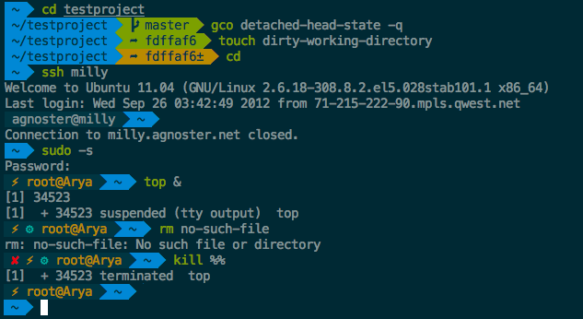
zsh
https://github.com/agnoster/agnoster-zsh-theme

Slide 19
/etc/shadow
RW only by root, R by shadow group
Date field are days (not seconds) since Jan 1, 1970
Stores encrypted passwords
“x” /etc/passwd entries
9 fields:
Login name
Encrypted password
Date of last password change
Minimum number of days between password changes
Maximum number of days between password changes
Number of days in advance to warn users about password expiration
Days after password expiration that account is disabled
Account expiration date
A field reserved for future use which is currently always empty
Notes:
The idea is to force authentic changes by preventing users from immediately reverting to a familiar password after a required change. However, this feature can be somewhat dangerous in the aftermath of a security intrusion. We suggest setting this field to 0.

Slide 20
Min # of days between password changes
Warning
Reserved for future use
Hashed Password
testuser:$6$YaimArFO$Irky4U6vstXuRs3vm.:18273:30:365:14:30:18321:
Login name
Expiration date
Date of last password change.
Max # of days between password changes
Days after expiration account is disable
Notes:
in days since Jan 1, 1970

Slide 21
Managing password age and expiry
NAME chage - change user password expiry information SYNOPSIS chage [options] LOGIN DESCRIPTION The chage command changes the number of days between password changes and the date of the last password change. This information is used by the system to determine when a user must change his/her password.

Slide 22
chage \ # -m 30 \ #Min days before password change
-M 365 \ #Max days for valid password
-W 14 \ #Warn 14 days before
-I 30 \ #Inactivity disable in days
-E 2020-02-29 \ #Expiry date
testuser

Slide 23
/etc/groups
Stores UNIX groups
Can be password protected
gpasswd
newgrp - User joins a group with a password
adduser creates a private group
adduser $USER $GROUP
Default Privileges
Audio - sound
Serial Ports - dialout
Display - vga
Sudo - wheel or sudo
Notes:
It’s possible to set a group password that allows arbitrary users to enter the group with the newgrp command.

Slide 24
/etc/groups
root:x:0: daemon:x:1: bin:x:2: sys:x:3: adm:x:4:syslog,zach tty:x:5: disk:x:6: lp:x:7: mail:x:8: dialout:x:20:zach
Group name
Encrypted password or a placeholder
GID number
List of members, separated by commas (be careful not to add spaces)

Slide 25
Groups
sudo
/etc/sudoers gives sudo permissions
dialout
/dev/ttyS{0..10} permissions. Serial ports.
audio
Audio permissions
lpadmin
Printer permissions
libvirtd
virt-manager permissions

Slide 26
Adding a group
addgroup [options] [--gid ID] group
addgroup --gid 5000 engr-admins
adduser someuser engr-admins #Debian\Ubuntu
usermod -G dialout -a zestreito #RHEL\CentOS
groupadd, groupmod, and groupdel #Universal

Slide 27
Adding users
Define account
Add /etc/passwd entry
vipw(1) - Why? lock files.
Does not check syntax
Add private group
/etc/group
vigr(1)
Set password
passwd
Create home directory
mkdir /home/$USER
chown $USER:$USER home directory
Configure roles and permissions

Slide 28
Adding users
adduser --home /home/someuser --shell --uid 6000 \ --gecos "Some User" --gid 6000 someuser
passwd someuser #interactive change
echo “someuser:${PW}” | chpasswd # Batch mode password change
adduser someuser somegroup
chage -d 0 testuser1 #force password change at next login
echo “umask 077” >> ~someuser/.bash_profile # 700 permissions

Slide 29
umask
/etc/login.defs
UMASK 022
libpam_mkhomedir.so
Essential for network users.
grep mkhomedir /etc/pam.d/* common-session:session optional pam_mkhomedir.so umask=077
#skel=/path/to/skel/directory #Indicate an alternative skel directory to override the default /etc/skel.

Slide 30
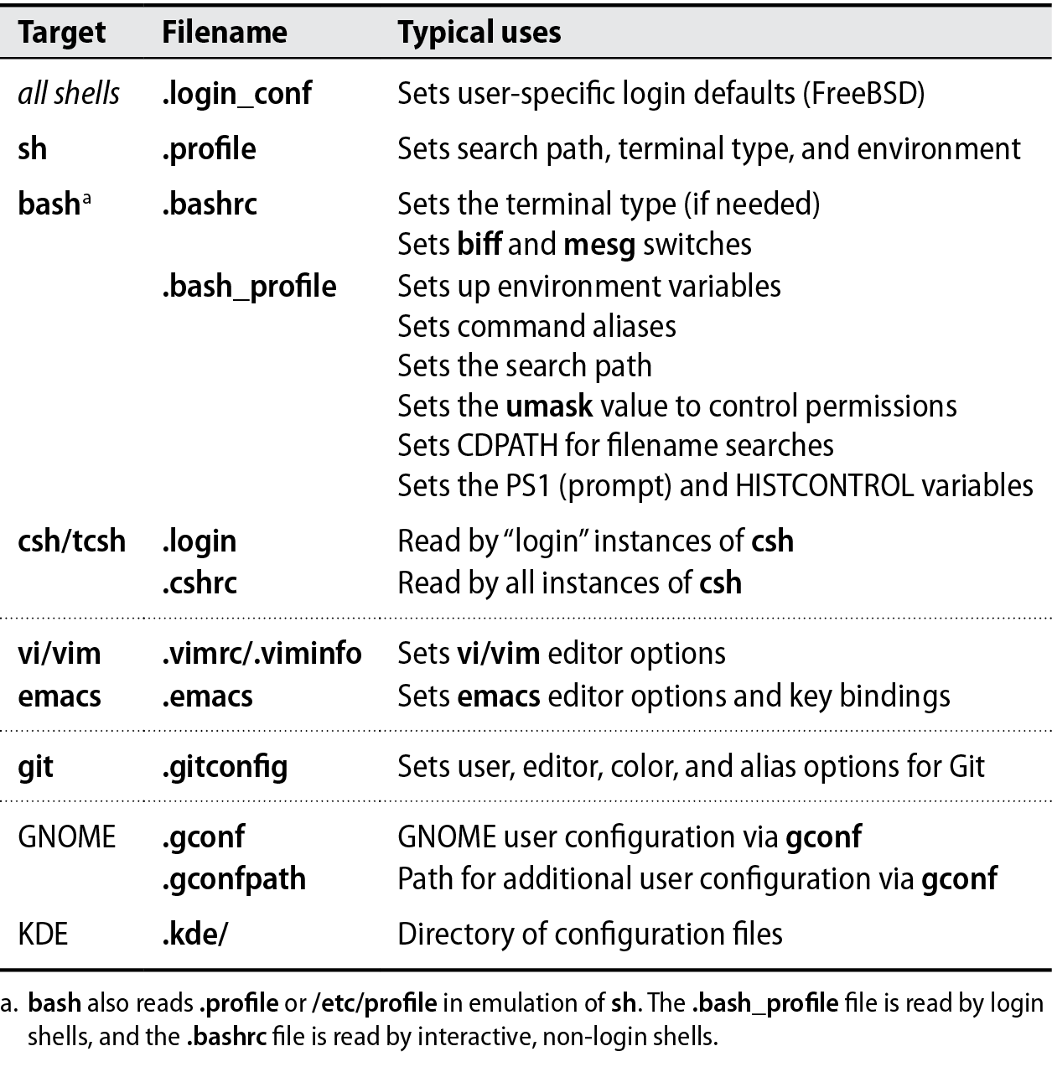
Adding users
Notes:
/etc/skel /usr/local/etc/skel

Slide 31
/etc/skel & /usr/local/etc/skel
ls -lha /etc/skel
total 12K drwxr-xr-x 1 root root 512 Jan 12 08:49 . drwxr-xr-x 1 root root 512 Jan 12 09:17 .. -rw-r--r-- 1 root root 220 Apr 4 2018 .bash_logout -rw-r--r-- 1 root root 3.7K Apr 4 2018 .bashrc -rw-r--r-- 1 root root 2.2K May 31 2017 .kshrc -rw-r--r-- 1 root root 807 Apr 4 2018 .profile

Slide 32
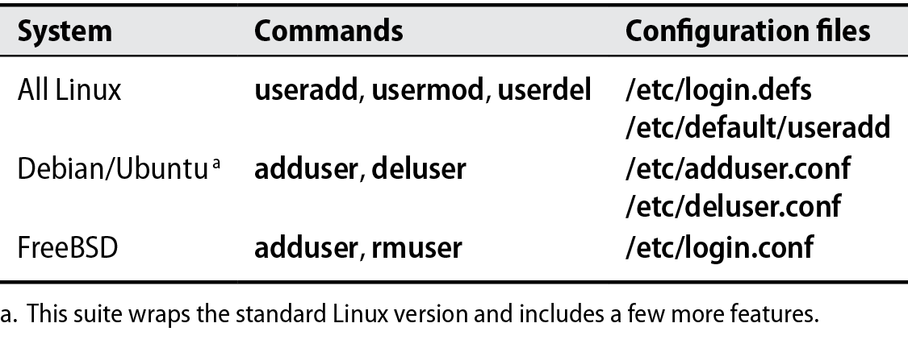
Scripting Local Accounts

Slide 33
Disabling and removing accounts
usermod -L someuser # Lock
usermod -U someuser # Unlock
deluser someuser # Delete user

Slide 34

Centralized Account Management
rsync /etc/passwd, /etc/group, /etc/shadow
Ansible
NIS - Networking Information Server
Network access based authentication and authorization
LDAP
Lightweight Directory Access Protocol
Most popular option
LDAP+KRB5 (Kerberos)
SSO
Ticket-based

Slide 35
Ansible
- name: Create cadmin user tags: - server-auth
user: name=cadmin state=present uid=8000 shell=/bin/bash groups="sudo" home='/usr/local/home/cadmin' password='$6$9dcUsI0p$siuhsd.ffewg3dss8

Slide 36
Centralized Account Management - NIS
Network Information Service (NIS)
Originally developed by Sun Microsystems in the 1980’s
Used to be named Yellow Pages
Renamed due to trademark
Services retain the yp*
ypbind - finds the NIS master
ypserv - Primary NIS master service
Exports
Groups
Users
Hostnames

Slide 37
Setting up NIS
time apt install nis #Wait forever
nano /etc/default/nis #master
nano /etc/yp.conf #client
systemctl restart nis #wait…
cd /var/yp && make
ypcat passwd
zcat /usr/share/doc/nis/nis.debian.howto.gz | less #2003!

Slide 38
Centralized Account Management - LDAP
Lightweight Directory Access Protocol
Small to large organizations
Enforces unique UIDs and GIDs
Largely replaced NIS
Mixed *nix and Windows infrastructure means AD
Kerberos
NIS additions not default
Notes:
OpenLDAP is the reference implementation
Hierarchical structure

Slide 39
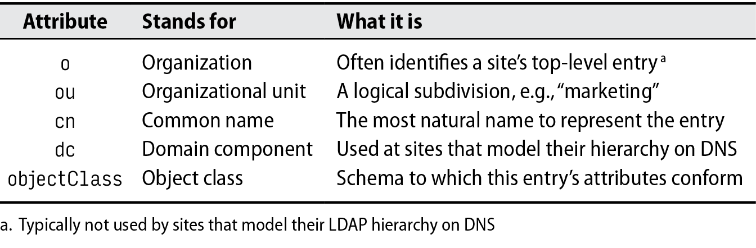

Slide 40
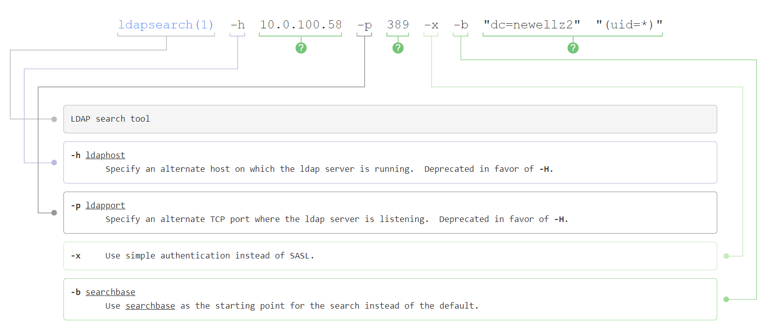
Searching LDAP

Slide 41
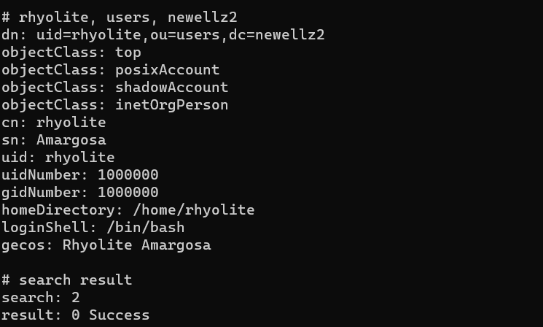

Slide 42
Searching UNR LDAP
ldapsearch \ -W \ -h unrdc04.unr.edu \ -p 389 -x -D "CN=Zachary A Newell,ou=Employees,ou=Users,ou=IT,dc=unr,dc=edu" \ -b "dc=unr,dc=edu" \ "sAMAccountName=newellz2*"
CN=$NAME,ou=$FLETTER,ou=NetID,ou=IT,dc=unr,dc=edu

Slide 43
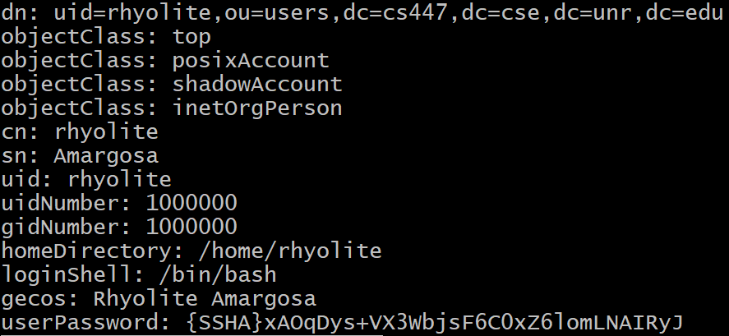
Adding a user the hard way...
ldapadd -x -w “qwerty” -D "cn=newellz2,dc=cs447" -f rhyolite.ldif
Notes:
LDIF = LDAP Data Interchange Format
Top - abstract class, enabled objectClass
-x simple auth
-W prompt for password
-D binddn

Slide 44
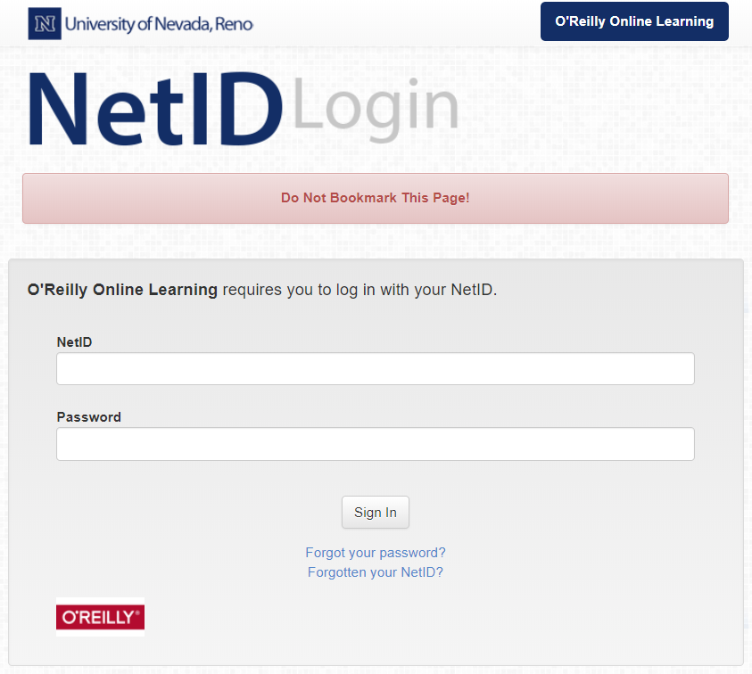
Centralized Account Management - SSO
Shibboleth - Open-source
UNR uses Shib
JOSSO - SSO Server
CAS - Central Authentication Service
Keycloak

Slide 45
Centralized Account Management - IAM
Identity Management Systems\Identity Access Management
Authentication
Granting Privileges
Largely Commercial
Microsoft
Oracle
Redhat
Web-based Management Interface
Role-based provisioning
Offboarding
Removing users from groups and access.
Notes:
Identity and Access Management

Slide 46
Centralized Account Management - IAM
Account Management
Unique login names, UIDs and GIDs
CRUD across an organization
Regardless of OS
Approval workflows
Reporting
Logging of all administrative actions
Ease of use
Users can update their own information and password
Global password changes
https://security.unr.edu/
Notes:
CRUD - Create, Read, Update, Delete
Who has access to the College of Engineering enrollment data?

Slide 47
Centralized Account Management - FreeIPA
Open-source version of Redhat IdM
Manages
Users
Groups
Machine Accounts
SSO
Uses
LDAP - Directory Server 389
Kerberos - MIT Kerberos 5
WWW - Python-based Web Application
Certificates - dogtag
DNS - bind9
Sudo

Slide 48
